Slide 1

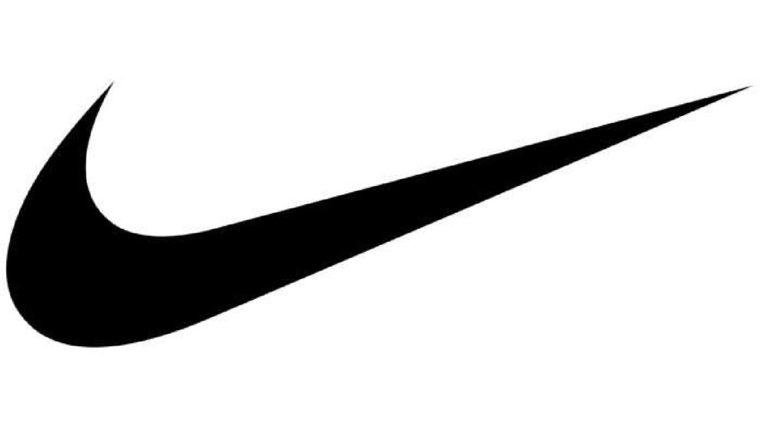
NIKE
FIN600101 - Corporate Finance
Fall 2023
Instructor: Dr. Xinyuan (Stacie) Tao

Slide 2

TABLE OF CONTENTS
01
02
03
04
Introductions
Data Analysis
Team, Company Overview, Problem Statement
Background, Charts, Metrics
Go or No Go?
Conclusion
In-Depth Evaluation

Slide 3

01
SECTION 01
Introductions

Slide 4
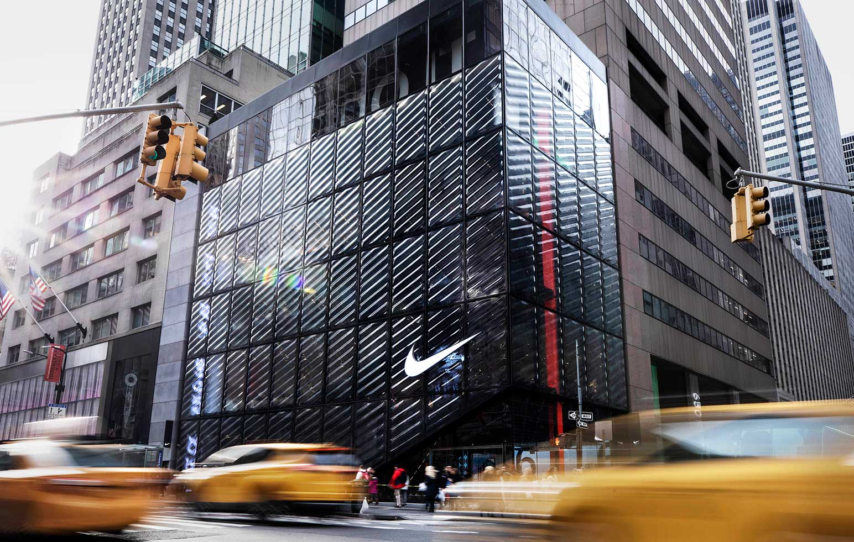
OUR TEAM
Alannah Aceridano
Architha Babu
Tech M.B.A. in Management
M.S. in Data Science
Christopher Henson
Abdul Azeem Mohammed
M.S. in Data Science
M.S. in Management
Sandra Sampath
M.S. in Data Science

Slide 5

NIKE OVERVIEW
Company name: Nike Inc. (formerly known as Blue Ribbon Sports)
Company founded: January 25, 1964
The company became public: in 1978
Ticker Symbol: NYSE: NKE
Current Market Cap: 164.5 billion USD
Introduction about Nike: An American multinational corporation that is engaged in the design, development, manufacturing, and worldwide marketing and sales of footwear, apparel, equipment, accessories, and services. The company is headquartered near Beaverton, Oregon, in the Portland metropolitan area. It is the world's largest supplier of athletic shoes and apparel and a major manufacturer of sports equipment.

Slide 6

THE PROBLEM
Objective of the project: Suppose you are the financial analyst of a given firm, you need to
conduct comprehensive analysis and offer the conclusive guidance to your clients whether
the firm is worthy to invest or not in the short run (such as next week or next month).

Slide 7

02
SECTION 02
Data Analysis

Slide 8
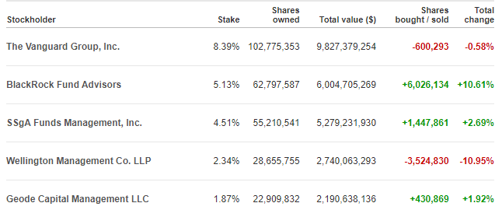
LARGEST STAKEHOLDERS OF NIKE

Slide 9
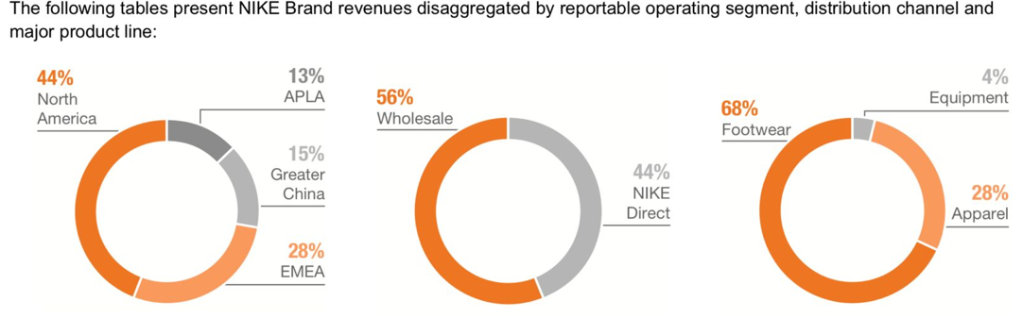
NIKE REVENUE BREAKDOWN

Slide 10
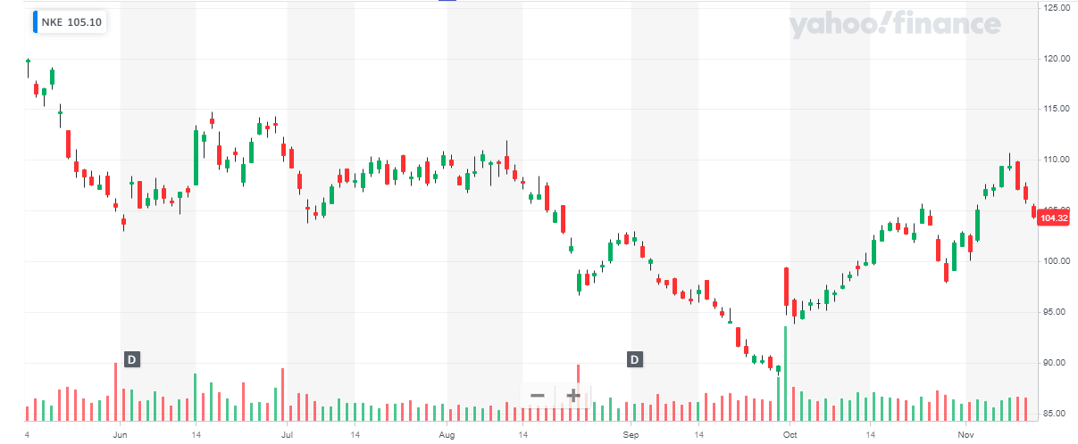
LAST 6 MONTHS PERFORMANCE OF NIKE

Slide 11
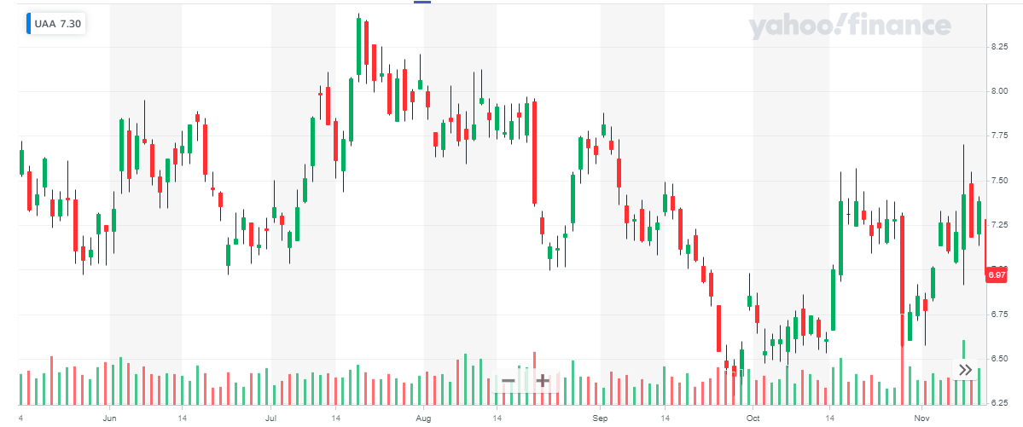
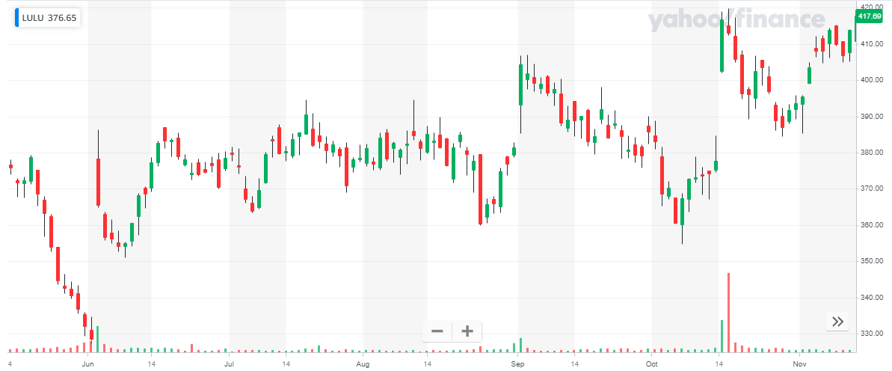
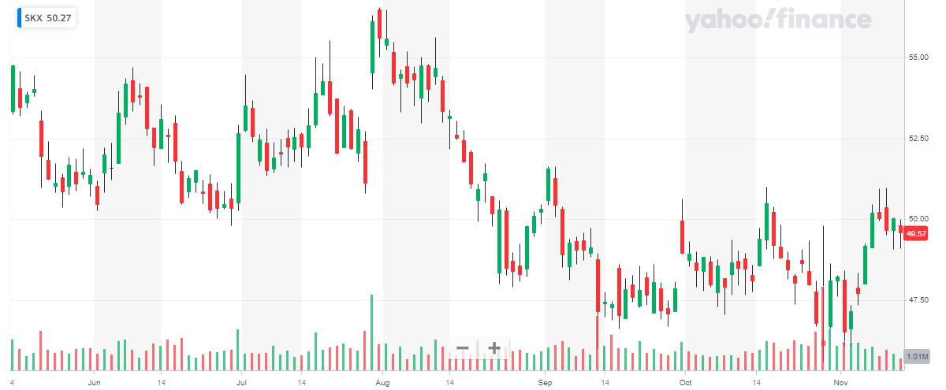
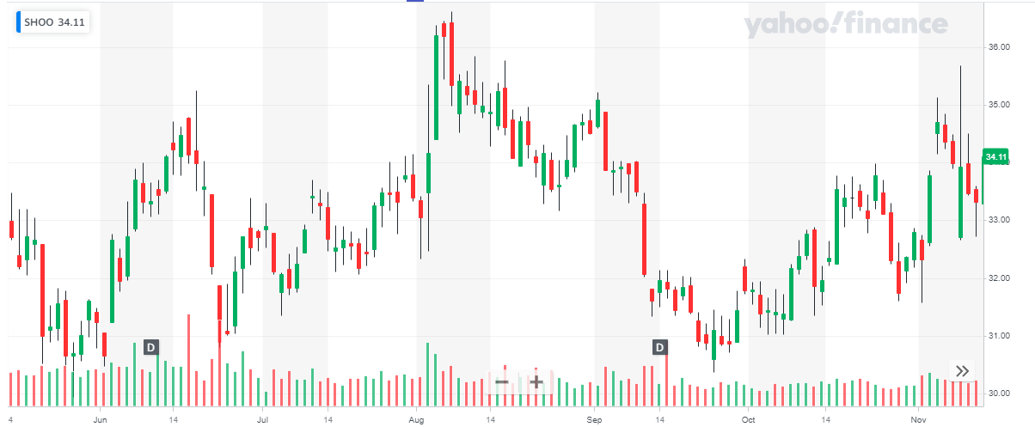
LAST 6 MONTHS PERFORMANCE OF NIKE COMPETITORS
Under Armor
Lululemon Athletica
Skechers
Steve Madden

Slide 12
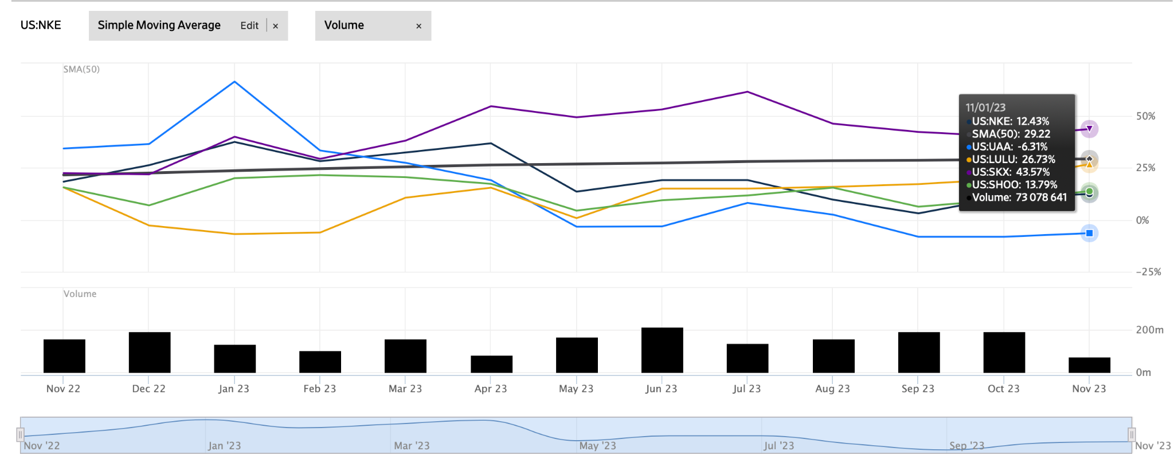
50 DAY SMA
Notes:
"In our analysis of Nike’s stock performance, we've employed the 50-day Simple Moving Average, or SMA, a key technical indicator that helps us understand the stock's trend. The 50-day SMA is essentially the average closing price of Nike's stock over the last 50 trading days. It smooths out short-term volatility and provides a clearer view of the longer-term price trend, making it a favorite tool among traders and investors. In the context of Nike, we've used the 50-day SMA to gauge the stock's momentum. When Nike’s current stock price is above this average, it's generally seen as a bullish sign, suggesting that the stock has strong upward momentum. Conversely, if the price falls below the SMA, it might indicate a bearish trend. It's a simple yet powerful way to assess market sentiment. However, it's important to remember that while the 50-day SMA is a useful tool for understanding market trends, it should be used in conjunction with other analyses and market indicators. This ensures a comprehensive and nuanced understanding of Nike's stock performance in the short term.”

Slide 13

RATIOS
P/E | 32.74 (TTM) | Net Profit Margin | 9.82%
Current Ratio and Quick Ratio | CR 2.87 QR 1.84 | Inventory Turnover | 0.83
ROE | 34.97% | Operating Margin | 9.82%
D/E | 0.64 | Dividend Yield | 1.29%
Notes:
"In analyzing Nike’s financial health and investment potential, we delved deep into various financial ratios, each providing a unique lens through which we can assess the company’s performance and valuation. Price-to-Earnings, or P/E Ratio, standing at 29.37. This is higher than the industry average, which suggests that the market might be expecting higher future earnings growth from Nike, or it could imply a premium valuation due to Nike's strong brand and market position.
Current Ratio and Quick Ratio. Nike’s current ratio is at 2.87, indicating that it has more than enough liquid assets to cover its short-term liabilities. This is a healthy sign, especially in unpredictable markets. The Quick Ratio, which excludes inventory from current assets, is at 1.84, further confirming Nike’s strong liquidity position.
The Return on Equity, or ROE, is another critical measure, and for Nike, it stands at an impressive 34.97%. This high ROE indicates Nike’s efficiency in generating profits from its equity, which is remarkable for a company of its size.
We also examined the Debt-to-Equity Ratio, which is at 0.64. This lower than average ratio implies that Nike is not overly reliant on debt to finance its operations, which is a positive sign in terms of financial stability.
Finally, the Net Profit Margin and Operating Margin stand at 9.82%. While these margins have room for improvement, they still reflect a healthy level of profitability, especially when viewed in the context of the broader industry challenges.
Taken together, these ratios paint a picture of a financially robust company with solid fundamentals. They highlight Nike’s ability to effectively manage its finances, generate profits, and sustain its operations, all of which are crucial considerations for a potential investment, especially in the short term.

Slide 14
Total footwear industry Nike
Market Cap - 206.65 Billion USD
PE Ratio - 29.07
Net Profit margin (FY24) - 9.21%
Annual dividend Yield - 1.62%
EPS - 0.73$
Market Cap - 164.5 Billion USD
PE Ratio - 32.74
Net Profit Margin (FY24) - 9.82%
Annual Dividend Yield - 1.26%
EPS - 0.94$

Slide 15

VALUATION ANALYSIS
Predicted Closing Price on 2023-11-29 : $105.92
Sequential Long Short-Term Memory (LSTM) neural network is implemented with TensorFlow and Keras in Python to obtain the predicted closing price of Nike on 11/29/2023.
The model is trained using historical stock prices of Nike from 11/15/2021 to 11/10/2023 obtained from Yahoo Finance.
Notes:
LSTM is a type of neural network that works by learning and remembering patterns in sequential data, allowing it to capture long-term dependencies and make accurate predictions, making it particularly effective for tasks like time series forecasting. We implemented LSTM using Python libraries such as TensorFlow and Keras by preparing historical closing price, training the model with it and optimizing using mean squared error loss and achieved a mean absolute error of $1.24.This suggests that, on average, the model's predictions deviate by approximately $1.24 from the actual closing prices of Nike stock.

Slide 16
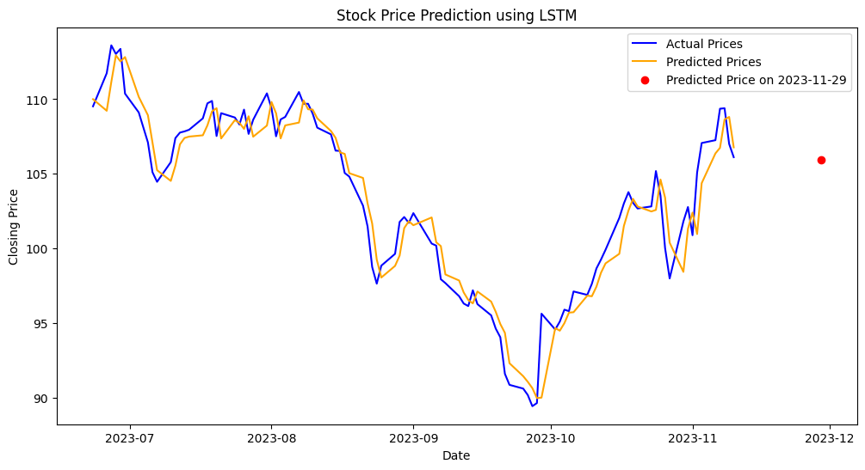
Notes:
Long Short-Term Memory (LSTM) model, a type of deep learning neural network, to predict Nike’s stock price movements in the short term. LSTM is particularly suited for analyzing time-series data like stock prices because of its ability to remember past data points, which is crucial for understanding complex patterns in financial markets. Our model was trained using historical stock price data, financial indicators, and market trends. It’s designed to capture not just the obvious trends but also the subtle nuances in Nike’s stock behavior over time. The model's output gives us a forecast of the stock’s future price based on this historical data. It’s important to note that while LSTM offers a sophisticated prediction, it's based on the assumption that past patterns are a good indicator of future performance.

Slide 17

03
SECTION 03
Go or No Go?

Slide 18

INVESTMENT
P/E Ratio
Revenue Growth
Operational Efficiency
Higher than industry average, premium investment justified
$51.2B in FY23, 16% increase YOY
Inventory decreases QOQ

Slide 19

04
SECTION 04
Conclusion

Slide 20

Why Nike?
Solid Financial Foundation
Inventory Management
Market Position and Brand Recognition
Technical Analysis and Market Sentiment
Valuation Metrics
Dividend Payout
LSTM Prediction

Slide 21

REFERENCES
DATA
Yahoo Finance
Zacks Investment Research
Wall Street Journal
PHOTOS
Google Photos

Slide 22

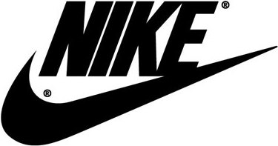
THANKS
Do you have any questions?

